Slide 1


Slide 2



This course material by Osama Salah is released under the following license:
Attribution-ShareAlike 4.0 International (CC BY-SA 4.0)
Conditions for use are published here:
https://creativecommons.org/licenses/by-sa/4.0/

Slide 3
Acknowledgement
I would like to thank and acknowledge the following people for their valuable contributions to this course material:
Have your name and effort acknowledged here!!!

Slide 4
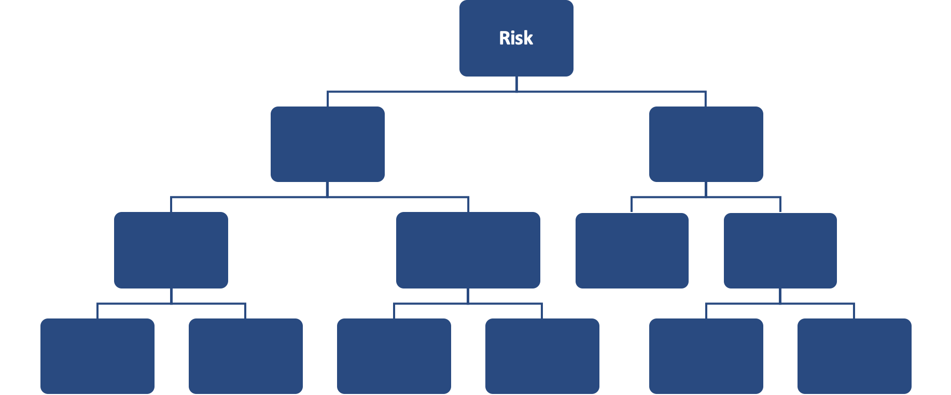
FAIR Open Course Module 3 - FAIR Risk Analysis Scoping Ver. 0.1 / Last Update: 14/09/2019

Slide 5
FAIR Risk Analysis
In this module we will focus on conducting a risk analysis using the FAIR model.
FAIR itself does not have specific guidance on how to conduct the risk analysis. However the book by Jack Jones and Jack Freund does provide guidance. Similar insights can also be gained from the numerous posts and videos made by practitioners at FAIRinstitute.org

Slide 6
Scoping
We start the process by focusing on scoping the risk analysis.
Scoping is a critical first step. Too often we jump to solutions without actually defining and understanding the problem.
How often have you when thinking about a risk already made up your mind about what needs to be done? Like, “We need to implement better endpoint solution”, “We need a security awareness program” etc.
From previous modules we learned that risks are experienced through loss events, thus first we will focus on defining and understanding loss events.

Slide 7






Scoping
Organized Crime
Cyber Criminals
Nation State
Hacktivist
Insiders
Privileged Insiders
Threat
Production
Customer Data
Strategies
R&D
Order Processing
…
Loss
Event
Confidentiality
Availability
Integrity
Safety
Asset
Effect
Notes:
Loss Events require 3 ingredients: A threat that will act against an asset which will have some effect.
Assets: as previously defined it is anything of value.
Threats: We typically look at threat communities. You will need a good understanding of the threat communities that are targeting you and which threat communities might be interested in which specific asset.
Effect: As for effect we classify them typically using the well known C-I-A. This is not a FAIR definition. It is possible to use other effect classification that might be useful for you. For some organizations Safety might be a high priority (Industries like Oil & Gas, Manufacturing etc.) for others it might be Privacy. An argument could also be made that Safety or Privacy might be effected by diminishing CIA and not directly. You will have to discuss and see what works best for your organization.

Slide 8
The Scenario
For the purpose of this course let’s envision a particular scenario and work through the analysis process.
The scenario is as follows:
The organization is a large marketing and advertising agency that handles marketing campaigns of fortune 500 companies. The partners have been following the news about ransomware attacks and are wondering what that would mean to them.

Slide 9
Scoping: The Assets
We typically start with understanding what assets could be impacted.
Some assets our organizations might have:
New Marketing Campaigns Material: Like designs for advertisements, campaign execution partnerships (newspapers, TV, online, celebrities), Confidential Information about new products, Market research
Private or confidential customer information
Asset
Campaign Material
Customer Information

Slide 10
Scoping: The Assets
To identify the assets you need to work closely with representatives of the business (Subject Matter Experts)
Some material that likely already exists in the organization that can be of use:
Value Chains and High level process documentation
Business Impact Analysis
Information Asset Register
Discuss
Discuss how the above information might be useful.
Can you think of any other sources to identify the critical assets relevant to our scenario?

Slide 11
Scoping: The Assets
Let’s assume we have only these two asset groups and they are processed or stored with the systems listed below.
Asset | Stored / Processed
Campaign Material | Cloud based Filesharing Platform
Customer Information | CRM System

Slide 12
Scoping: The Threat
Discuss
What do you believe the threat community is in this scenario and why?

Slide 13
Scoping: The Threat
Since management brought up the concern related to ransomware our threat community is most likely “Cyber Criminals”.
There might be other threat communities that might cause us harm, like for example insiders, but typically these would not use ransomware. If we are worried about insider threats we would need to make another risk analysis specifically for that threat community.
Even if we assume the cyber criminals use an insider to plant the ransomware then this is variation of the cyber criminal scenario. It’s probably are more complex scenario and thus less likely to occur, but the point really is that focusing on the less complex scenario and understanding it is the best starting point. There will be opportunities later to investigate variations.

Slide 14
Scoping: The Threat
Asset | Threat
Campaign Material | Cyber Criminals
Customer Information | Cyber Criminals

Slide 15
Scoping: The Effect
Discuss
Let us consider the three effect types:
Confidentiality
Integrity
Availability
Which might apply to our scenario?
Asset | Threat
Campaign Material (Files) | Cyber Criminals
Customer Information (CRM) | Cyber Criminals

Slide 16
Scoping: The Effect
Ransomware typically leaves the data where it is but encrypts it or locks the workstations from which the data can be accessed.
In both cases the data is inaccessible which means this effects availability.
Confidentiality and integrity are not typically effects in ransomware scenarios.
In this scenario the Customer Information it is becoming unavailable because the workstations used to access the CRM system become unavailable (locked). The data in the CRM data base remains untouched.

Slide 17
Scoping: The Effect
Incorporating the effect creates two scenarios. Had we identified additional effects we would have to create additional scenarios.
Any additional of asset, threat or effect typically creates a new specific scenario as it likely will have an impact on loss event frequency and/or loss magnitude.
Asset | Threat | Effect
Campaign Material | Cyber Criminals | Availability
Customer Information | Cyber Criminals | Availability

Slide 18
Scoping
We started with management being worried about ransomware, but now we have a better picture of the risks that need to be analyzed.
Translating the tables into plain English:
Scenario 1: Analyze the risk associated with cyber criminals attacking our campaign material repository using ransomware to encrypt the data and lock out workstations.
Scenario 2: Analyze the risk associated with cyber criminals deploying ransomware locking us out from workstations preventing access to CRM system.

Slide 19
Scoping
If you notice we can actually drop scenario 2 as it is covered by scenario 1.
If ransomware is deployed in scenario one it will encrypt the data stored in the file system and will lock users out from workstations which will prevent access to CRM system (and everything else) as well.
Asset | Threat | Effect
Campaign Material and CRM system | Cyber Criminals | Availability

Slide 20
Scoping and Scenario Aggregation
Usually we try to keep it simple and avoid combining multiple scenarios into one.
One approach is to analyze multiple simple scenarios and use risk aggregation at the end.

Slide 21
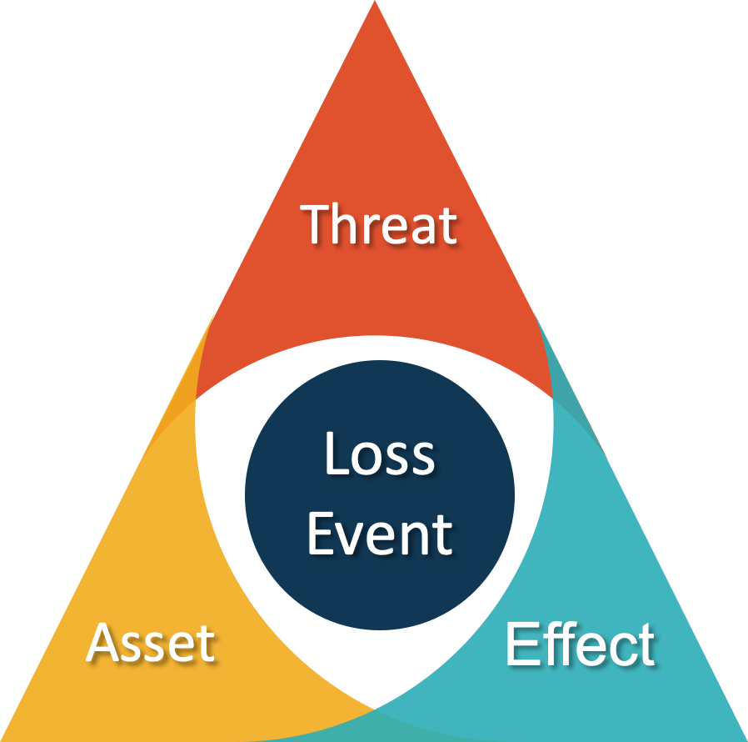
Scoping Exercises
Now that we know how to better scope risk analysis statements, let’s try out this new skill.
Mention anything that might worry you or management and scope a useful risk statement.
To keep you going we typically hear organizations being worried about: Rogue administrator, Phishing attacks, Mobile devices…etc.

